Slide 1



chapter 12
cognitive models

Slide 2
Cognitive models
goal and task hierarchies
linguistic
physical and device
architectural

Slide 3
Cognitive models
They model aspects of user:
  understanding
  knowledge
  intentions
  processing
Common categorisation:
  Competence vs. Performance
  Computational flavour
  No clear divide

Slide 4
Goal and task hierarchies
Mental processing as divide-and-conquer
Example: sales report
  produce report
  gather data
  . find book names
  . . do keywords search of names database
  . . . … further sub-goals
  . . sift through names and abstracts by hand
  . . . … further sub-goals
  . search sales database
  … further sub-goals
  layout tables and histograms
  … further sub-goals
  write description
  … further sub-goals

Slide 5
goals vs. tasks
goals – intentions
    what you would like to be true
tasks – actions
    how to achieve it
GOMS – goals are internal
HTA – actions external
– tasks are abstractions

Slide 6
Issues for goal hierarchies
Granularity
  Where do we start?
  Where do we stop?
Routine learned behaviour, not problem solving
  The unit task
Conflict
  More than one way to achieve a goal
Error

Slide 7
Techniques
Goals, Operators, Methods and Selection (GOMS)
Cognitive Complexity Theory (CCT)
Hierarchical Task Analysis (HTA)

Slide 8
GOMS
Goals
  what the user wants to achieve
Operators
  basic actions user performs
Methods
  decomposition of a goal into subgoals/operators
Selection
  means of choosing between competing methods

Slide 9
GOMS example
GOAL: CLOSE-WINDOW
. [select GOAL: USE-MENU-METHOD
. MOVE-MOUSE-TO-FILE-MENU
. PULL-DOWN-FILE-MENU
. CLICK-OVER-CLOSE-OPTION
GOAL: USE-CTRL-W-METHOD
. PRESS-CONTROL-W-KEYS]
For a particular user:
Rule 1: Select USE-MENU-METHOD unless another
rule applies
Rule 2: If the application is GAME,
select CTRL-W-METHOD

Slide 10
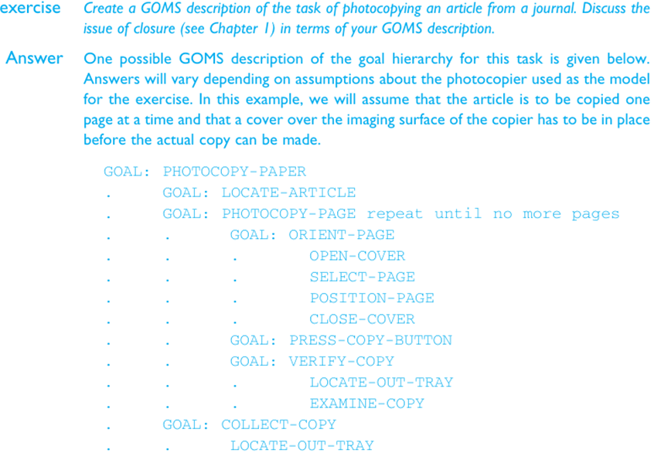

Slide 11
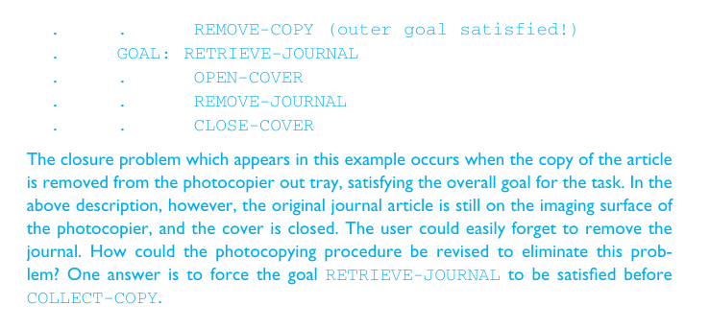

Slide 12
Cognitive Complexity Theory
Two parallel descriptions:
  User production rules
  Device generalised transition networks
Production rules are of the form:
  if condition then action
Transition networks covered under dialogue models

Slide 13
Example: editing with vi
Production rules are in long-term memory
Model working memory as attribute-value mapping:
  (GOAL perform unit task)
  (TEXT task is insert space)
  (TEXT task is at 5 23)
  (CURSOR 8 7)
Rules are pattern-matched to working memory,
  e.g., LOOK-TEXT task is at %LINE %COLUMN
  is true, with LINE = 5 COLUMN = 23.

Slide 14
Four rules to model inserting a space
Active rules:
SELECT-INSERT-SPACE
INSERT-SPACE-MOVE-FIRST
INSERT-SPACE-DOIT
INSERT-SPACE-DONE
New working memory
(GOAL insert space)
(NOTE executing insert space)
(LINE 5) (COLUMN 23)
SELECT-INSERT-SPACE
matches current working memory
(SELECT-INSERT-SPACE
IF (AND (TEST-GOAL perform unit task)
(TEST-TEXT task is insert space)
(NOT (TEST-GOAL insert space))
(NOT (TEST-NOTE executing insert space)))
THEN ( (ADD-GOAL insert space)
(ADD-NOTE executing insert space)
(LOOK-TEXT task is at %LINE %COLUMN)))

Slide 15
Notes on CCT
Parallel model
Proceduralisation of actions
Novice versus expert style rules
Error behaviour can be represented
Measures
  depth of goal structure
  number of rules
  comparison with device description

Slide 16
Problems with goal hierarchies
a post hoc technique
expert versus novice
How cognitive are they?

Slide 17
Linguistic notations
Understanding the user's behaviour and cognitive difficulty based on analysis of language between user and system.
Similar in emphasis to dialogue models
Backus–Naur Form (BNF)
Task–Action Grammar (TAG)

Slide 18
Backus-Naur Form (BNF)
Very common notation from computer science
A purely syntactic view of the dialogue
Terminals
  lowest level of user behaviour
  e.g. CLICK-MOUSE, MOVE-MOUSE
Nonterminals
  ordering of terminals
  higher level of abstraction
  e.g. select-menu, position-mouse

Slide 19
Example of BNF
Basic syntax:
  nonterminal ::= expression
An expression
  contains terminals and nonterminals
  combined in sequence (+) or as alternatives (|)
draw line ::= select line + choose points + last point
select line ::= pos mouse + CLICK MOUSE
choose points ::= choose one | choose one + choose points
choose one ::= pos mouse + CLICK MOUSE
last point ::= pos mouse + DBL CLICK MOUSE
pos mouse ::= NULL | MOVE MOUSE+ pos mouse

Slide 20
Measurements with BNF
Number of rules (not so good)
Number of + and | operators
Complications
  same syntax for different semantics
  no reflection of user's perception
  minimal consistency checking

Slide 21
Task Action Grammar (TAG)
Making consistency more explicit
Encoding user's world knowledge
Parameterised grammar rules
Nonterminals are modified to include additional semantic features

Slide 22
Consistency in TAG
In BNF, three UNIX commands would be described as:
  copy ::= cp + filename + filename | cp + filenames + directory
  move ::= mv + filename + filename | mv + filenames + directory
  link ::= ln + filename + filename | ln + filenames + directory
No BNF measure could distinguish between this and a less consistent grammar in which
  link ::= ln + filename + filename | ln + directory + filenames

Slide 23
Consistency in TAG (cont'd)
consistency of argument order made explicit using a parameter, or semantic feature for file operations
Feature Possible values
  Op = copy; move; link
Rules
  file-op[Op] ::= command[Op] + filename + filename
  | command[Op] + filenames + directory
  command[Op = copy] ::= cp
  command[Op = move] ::= mv
  command[Op = link] ::= ln

Slide 24
Other uses of TAG
User’s existing knowledge
Congruence between features and commands
These are modelled as derived rules

Slide 25
Physical and device models
The Keystroke Level Model (KLM)
Buxton's 3-state model
Based on empirical knowledge of human motor system
User's task: acquisition then execution.
  these only address execution
Complementary with goal hierarchies

Slide 26
Keystroke Level Model (KLM)
lowest level of (original) GOMS
six execution phase operators
  Physical motor: K - keystroking
  P - pointing
  H - homing
  D - drawing
  Mental M - mental preparation
  System R - response
times are empirically determined.
    Texecute = TK + TP + TH + TD + TM + TR

Slide 27
KLM example
GOAL: ICONISE-WINDOW
[select
GOAL: USE-CLOSE-METHOD
. MOVE-MOUSE-TO- FILE-MENU
. PULL-DOWN-FILE-MENU
. CLICK-OVER-CLOSE-OPTION
GOAL: USE-CTRL-W-METHOD
PRESS-CONTROL-W-KEY]
compare alternatives:
  USE-CTRL-W-METHOD vs.
  USE-CLOSE-METHOD
assume hand starts on mouse
USE-CTRL-W-METHOD
H[to kbd] 0.40
M 1.35
K[ctrlW key] 0.28
Total 2.03 s
USE-CLOSE-METHOD
P[to menu] 1.1
B[LEFT down] 0.1
M 1.35
P[to option] 1.1
B[LEFT up] 0.1
Total 3.75 s

Slide 28
Architectural models
All of these cognitive models make assumptions about the architecture of the human mind.
Long-term/Short-term memory
Problem spaces
Interacting Cognitive Subsystems
Connectionist
ACT

Slide 29
Display-based interaction
Most cognitive models do not deal with user observation and perception
Some techniques have been extended to handle system output
(e.g., BNF with sensing terminals, Display-TAG)
but problems persist
Exploratory interaction versus planning

